Slide 1
Computer Vision Car license plate detection
Emanuele Corongiu
Notes:
Goodmorning every one today I will talk about computer vision particolary i will focus on license plate detection

Slide 2
Summary
Problem configuration
Possible solutions
Yolo V8
Training and input Data
Training and result
Tracking

Slide 3
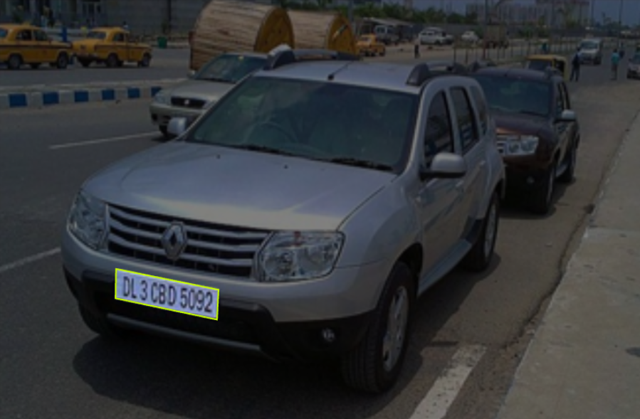
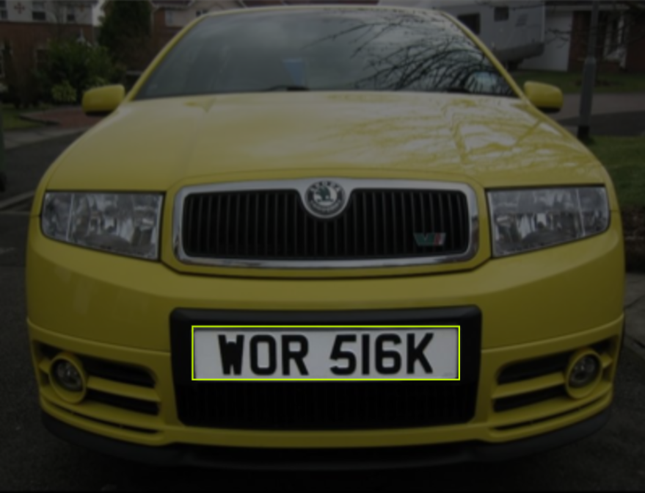
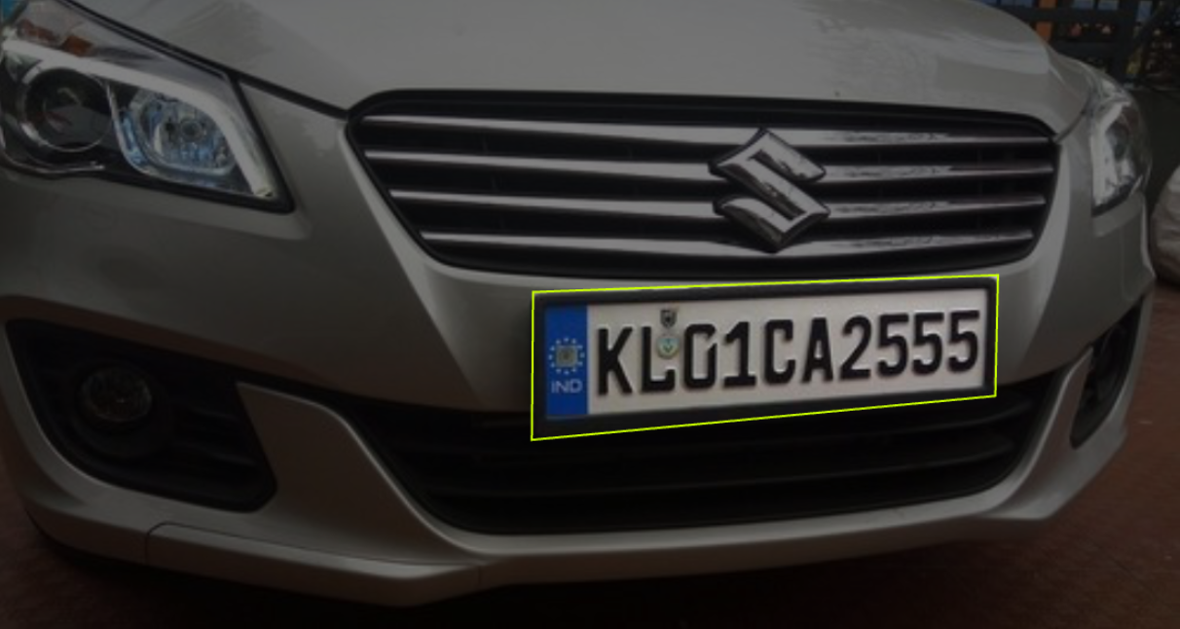
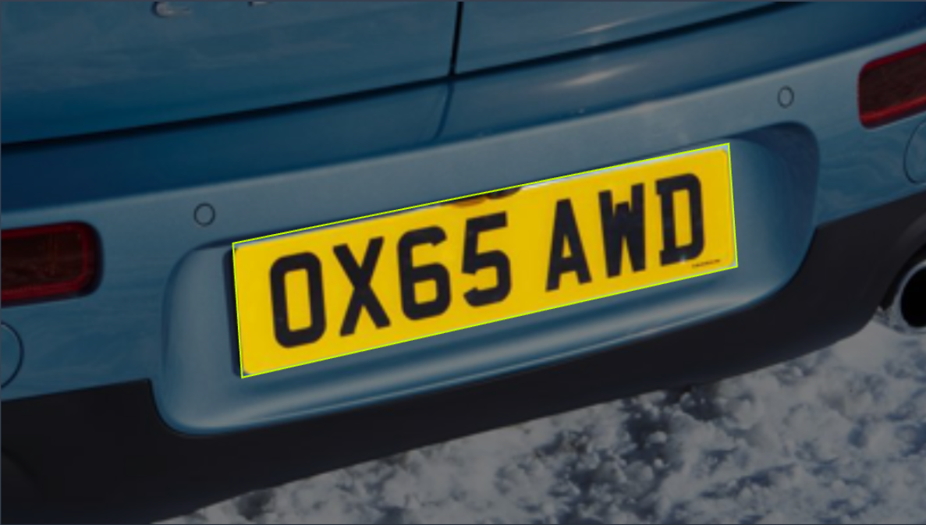
Problem Configuration
Images source: How to Use the carPlate Object Detection API (roboflow.com)
Notes:
My project was focused on detecting license plates of cars. In this kind of problem we have for example a road and we want to detect the license plate of a car crossing when it cannot. And maybe we also want to detect the license plate.

Slide 4
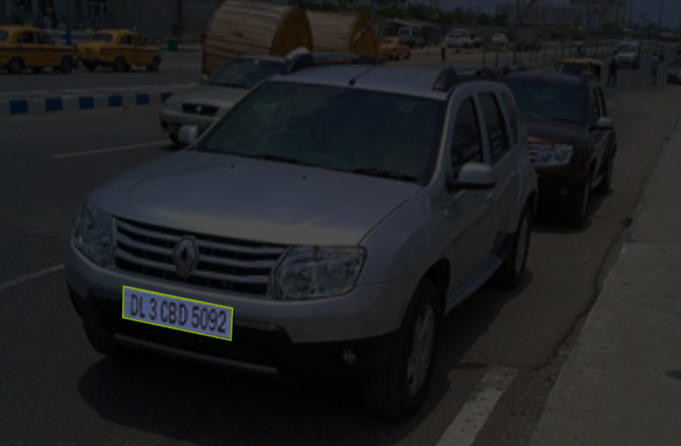
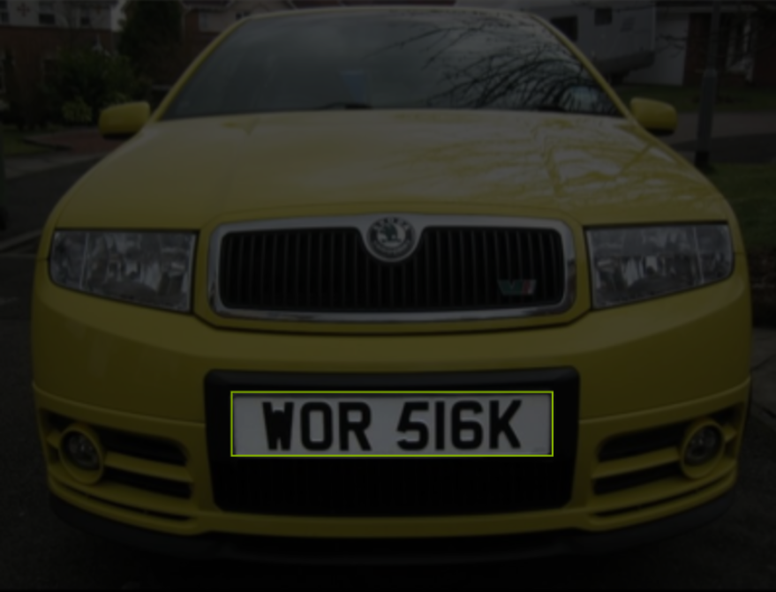
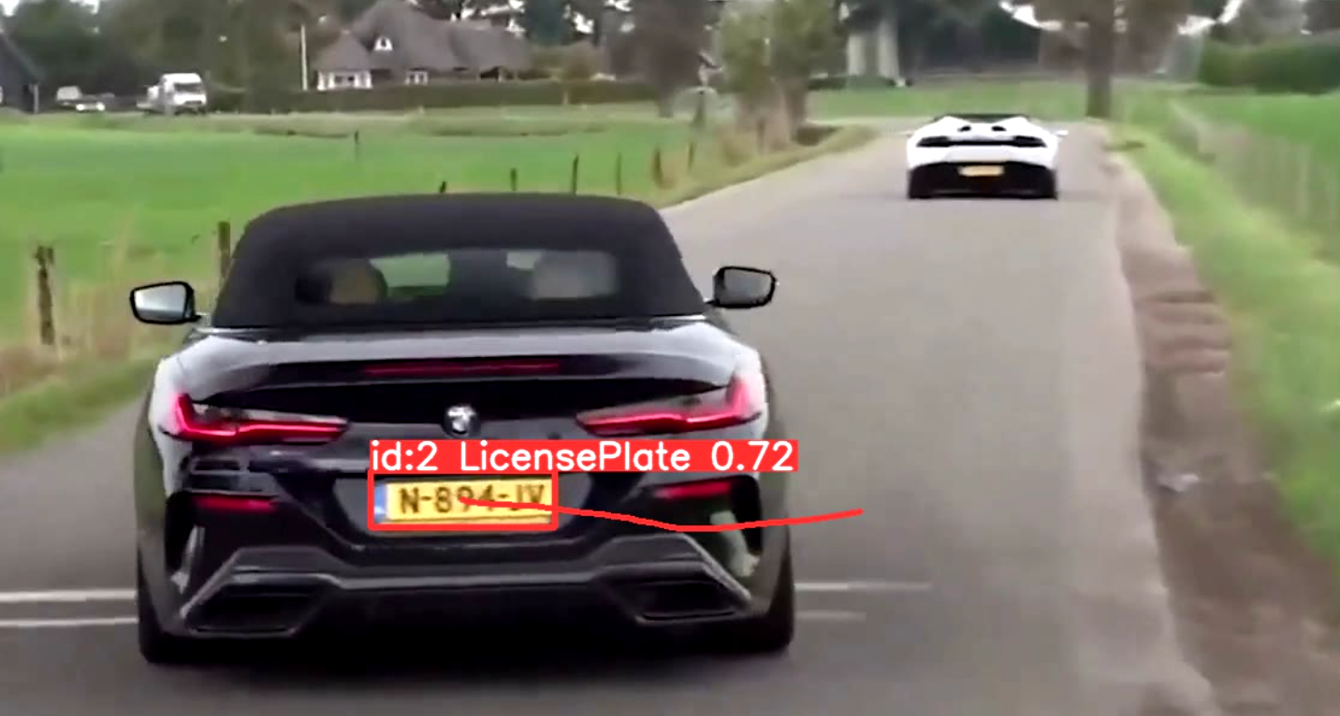
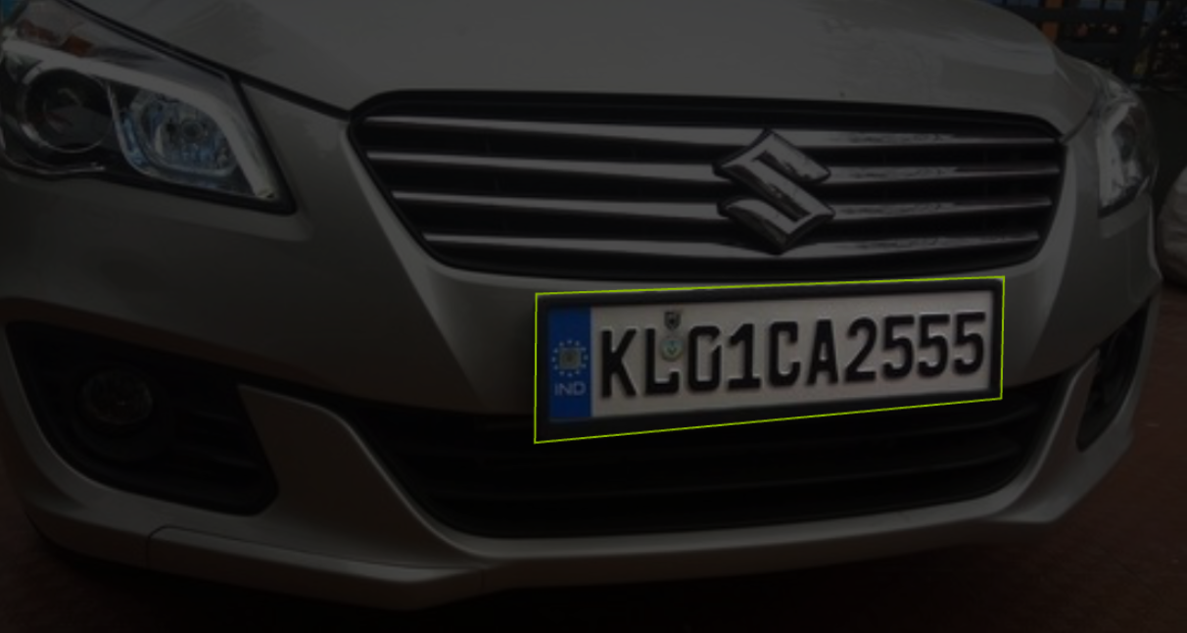
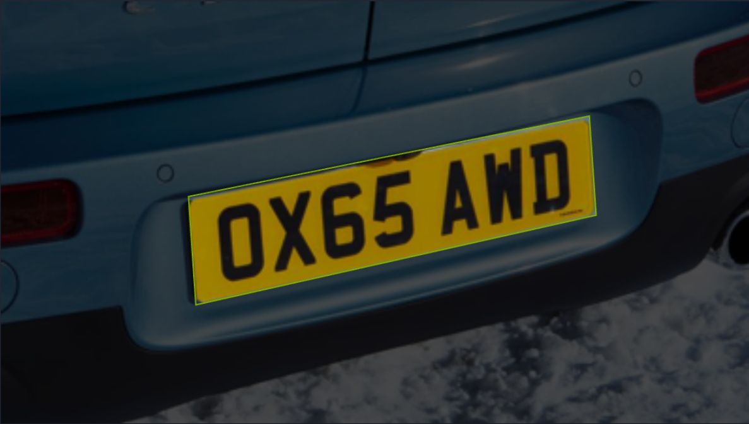
Problem Configuration
Images source: How to Use the carPlate Object Detection API (roboflow.com) https://github.com/Arijit1080/Licence-Plate-Detection-using-YOLO-V8
Notes:
Sometimes also it is not enough to detect a license plate and maybe we would also like to trace it in the frames. And that's what I've learned to do

Slide 5
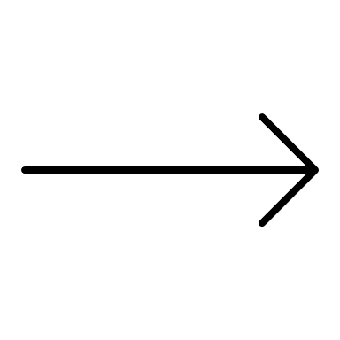
Possible solutions
Classic Image processing techniques
Machine learning techniques
As example is CV library
Yolo V8
Images source: How to Use the carPlate Object Detection API (roboflow.com) https://github.com/Arijit1080/Licence-Plate-Detection-using-YOLO-V8
Notes:
Searching in the licteractur it can be seen that the detection of a licens plate can be obtained with classic image processing techniques using for exemple knowns CV libraries or a machine learning approch

Slide 6
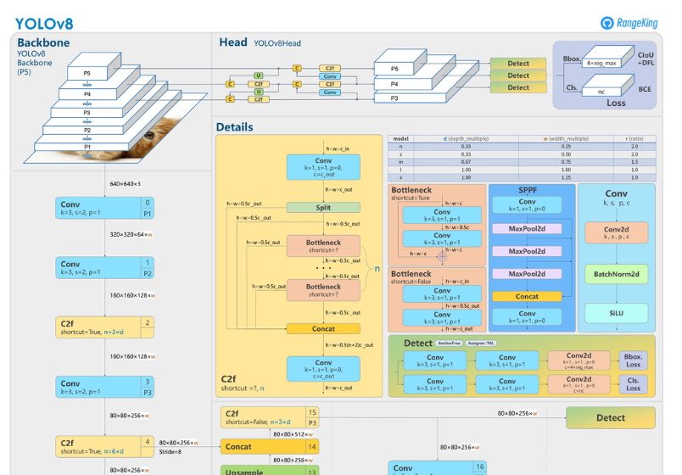
Yolo V8
Is based on machine learning techniques and allows to perform many operations such as detection and tracking.
Image source: What is YOLOv8? The Ultimate Guide. (roboflow.com)
Notes:
For this task i used YOLO v8 that is a userful tool It is based on a convolutional neural networks and allow to do the detection and the tracking.

Slide 7

Yolo V8
DETECTION!
Image with car license plate
YOLO V8
or
TRACKING!
Notes:
In this simple scheme we can see that we can give in intput to yolo V8 an image or a video and then we can obtaint in ooutput a detection or a trackig dependig on the desired task.

Slide 8
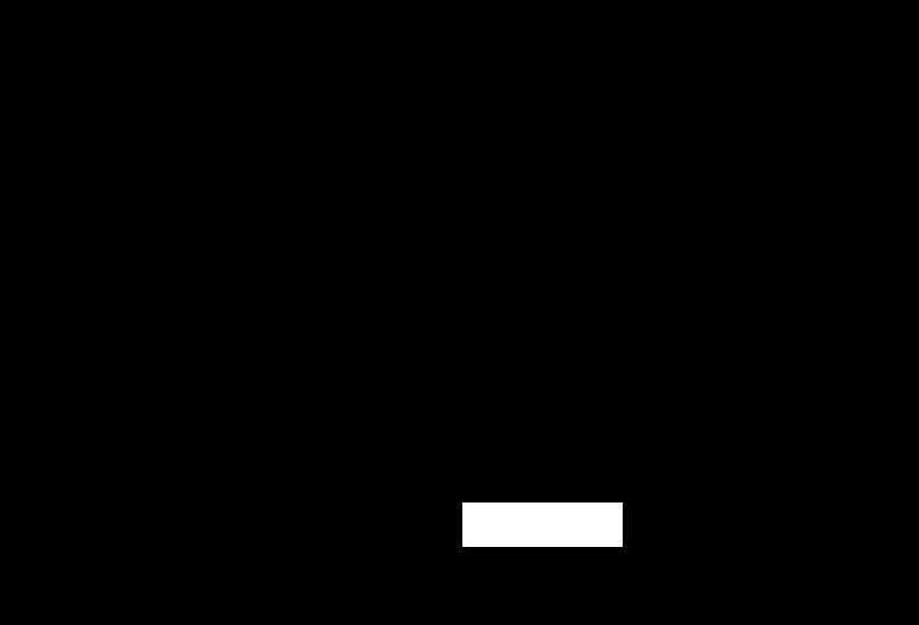
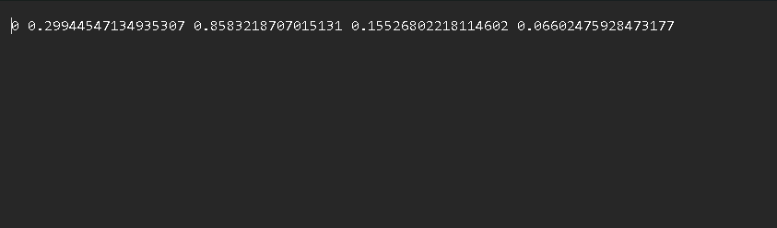
Training and input data
Data input to the model can be given in different ways, such as through binary masks or through a text file.
In some cases, therefore, the pre-processing phase before training can be a challenge.
Images source: How to Use the carPlate Object Detection API (roboflow.com) https://github.com/Arijit1080/Licence-Plate-Detection-using-YOLO-V8
Notes:
To make a forecast we need a trained model. So the first step for me was training the model. To do this, the most important thing is the quality of the data used in the training step. In this case I used Yolo v8 nano, which is the smallest model of yolo v8. It can be easily trained by giving as input some images and for each of them a text file that contains information about the objects within the image. This information is in the form of the coordinates of a bounded box and the first number is the class, in this case class 0 is the license plate of a car. If the dataset we have is not in this form, we have to convert it and that can be a challenge. In the last 2 experiments I worked with datasets that were already in the YOLO format for simplicity.

Slide 9
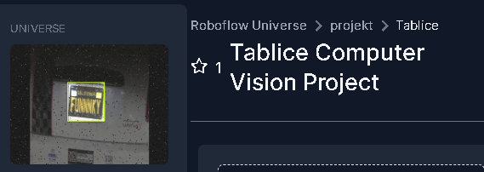
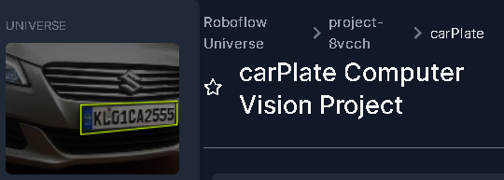
Training and input data
Images source: How to Use the carPlate Object Detection API (roboflow.com) https://github.com/Arijit1080/Licence-Plate-Detection-using-YOLO-V8
Tablice Dataset (roboflow.com)
carPlate Dataset (roboflow.com)
Notes:
I used two datasets where the principal difference is in the number of images, the first is about 300 and the second is about 8000

Slide 10
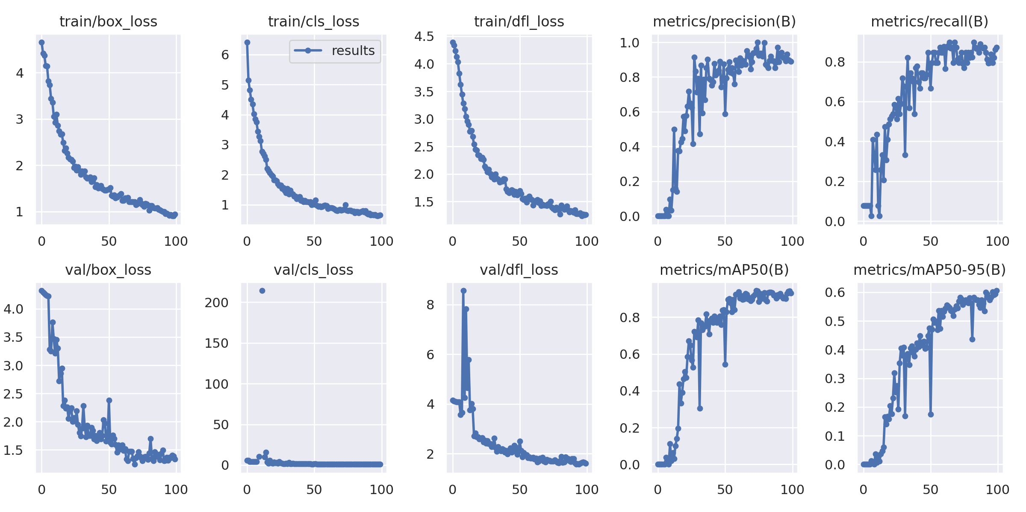
Training and results
With the small dataset: about 300 images in total
Notes:
This image show some important information about the trainign result for the first dataset. We can see that in general the curves are not to mutch smooth but that we get not that bad performarnce in the end, and in fact in some tracking experiments the model works well

Slide 11
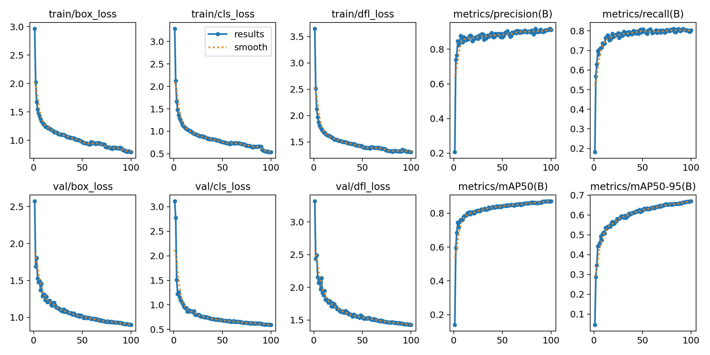
Training and results
With the big dataset: about 8000 images in total
Notes:
Now we can see the results with the big dataset, the curves are smooth and we can see that the model learned quite well respect to the previus images. In the experiments i otained more relaiable detection with this model as expected.

Slide 12
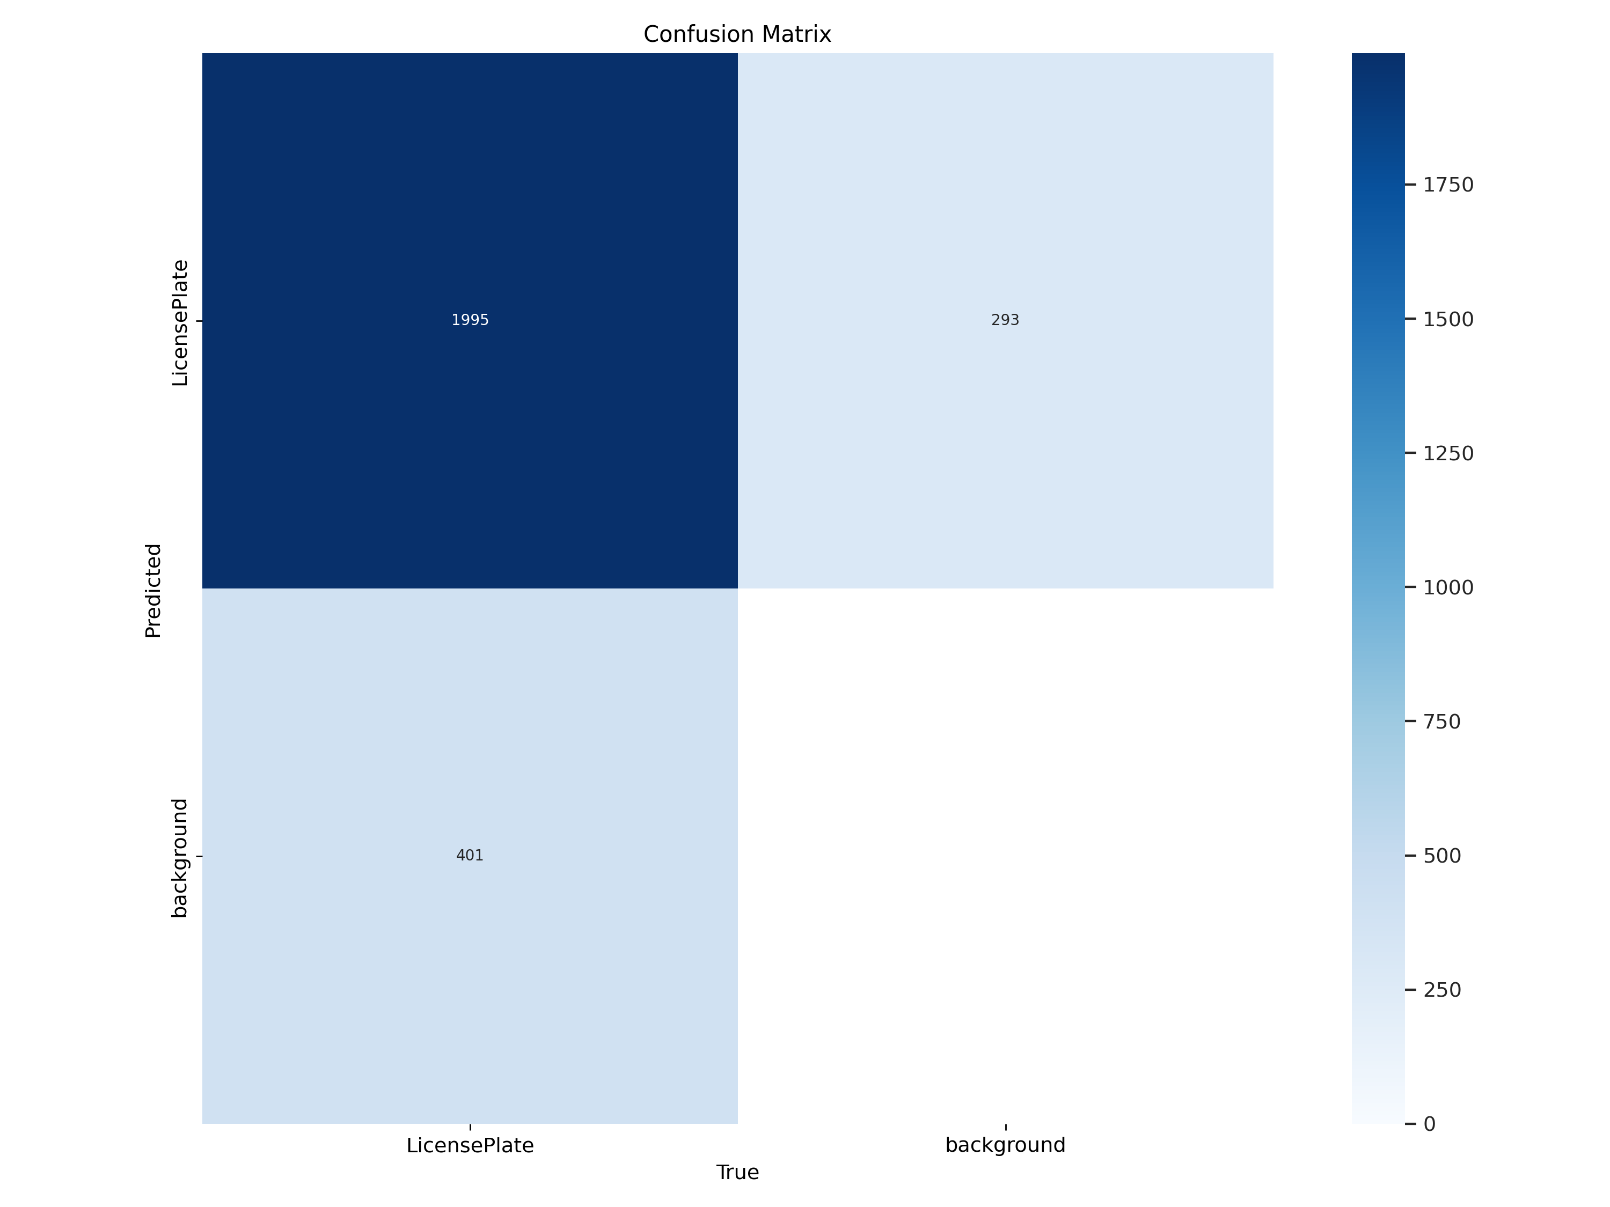
Training and results
Notes:
For this last dataset we can also see the F1 curve that take into account recall and precision metrics and the confusion matrix where we can see that the number of true positive is very hight respect to the false positive and the false negative as expected. The false negative are not take into account in this case.

Slide 13
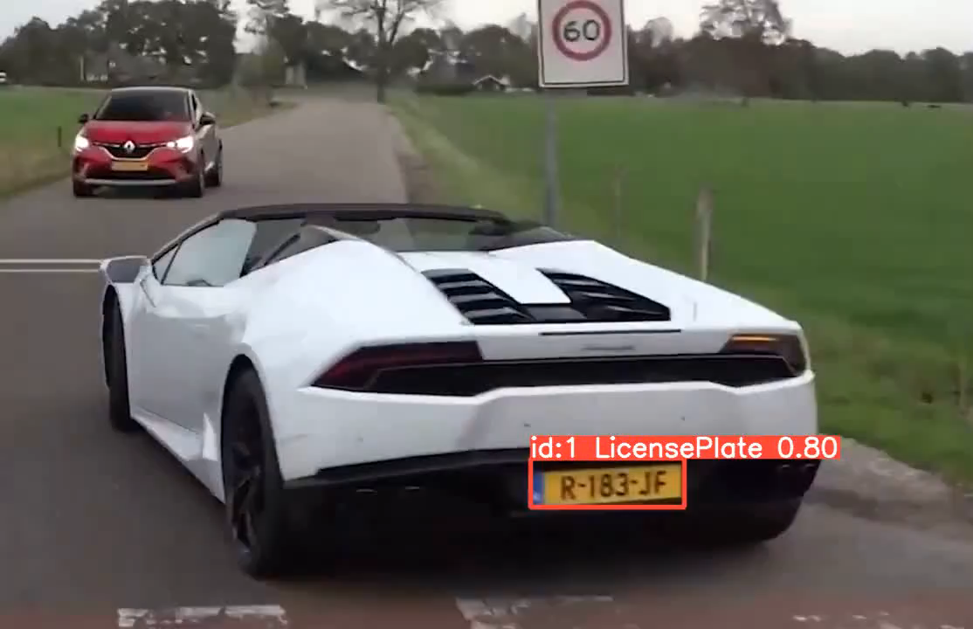
Tracking
The ouput of YOLO in tracking mode
Video demo source: https://github.com/Arijit1080/Licence-Plate-Detection-using-YOLO-V8
Notes:
After the training I tried the tracking function of YOLO v8 with a simple video and this is the result.

Slide 14
Thanks for the attention

